Slide 1
Regression Model Evaluation
MAE, MSE, RMSE, R², Residual Plots & Model Selection

Slide 2
Why is Regression Model Evaluation?
Regression predicts continuous values (e.g., house price, marks).
But how do we know if the model is good?
We use metrics & visualizations to evaluate.

Slide 3
Mean Absolute Error (MAE)
Formula: MAE = (1/n) Σ |y - ŷ|
Meaning: Average of absolute errors.
Pros: Easy to understand, less sensitive to outliers.
Cons: Ignores direction of error.
Example: MAE = 5 implies On average, predictions are off by 5 units.

Slide 4
Mean Squared Error (MSE)
Formula: MSE = (1/n) Σ (y - ŷ)²
Meaning: Average of squared errors.
Pros: Penalizes large errors more.
Cons: Harder to interpret (squared units).

Slide 5
Root Mean Squared Error (RMSE)
Formula: RMSE = √MSE
Meaning: Similar to MAE but gives more weight to large errors.
Pros: Same unit as data, easier to explain.
Example: RMSE = 7 implies Predictions deviate by ~7 units on average.

Slide 6
R² Score (Coefficient of Determination)
Formula: R² = 1 - SS_{res}
Ss_{tot}
The coefficient of determination/R² is a statistical measure that provides information about the goodness of fit of a model.
R² value denotes the % of variation in the dependent variable explained by the independent variable in the regression model.
Range: -∞ to 1
Closer to 1 implies Better fit.
Example: R² = 0.85 means Model explains 85% of variance.

Slide 7
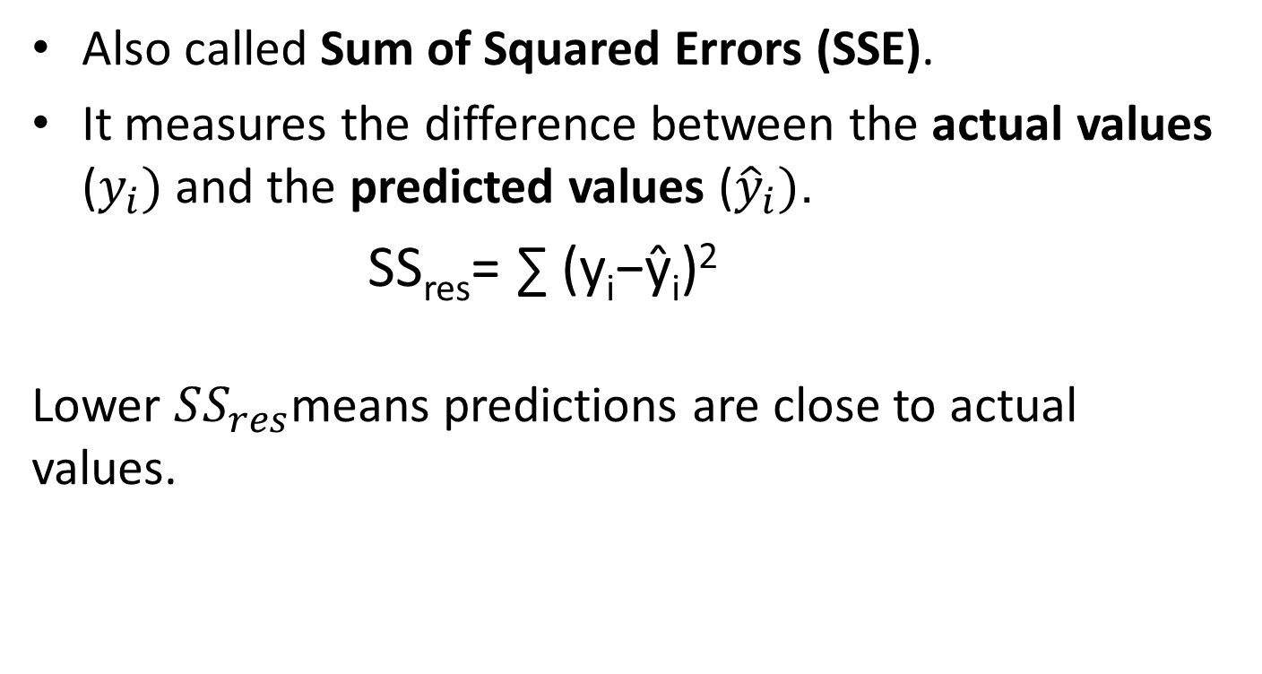
SS_{res} (Residual Sum of Squares)
Also called Sum of Squared Errors (SSE).
It measures the difference between the actual values ($y_{i})$and the predicted values (${\hat{y}}_{i})$.
SS_{res}​= ∑ (y_{i}​−ŷ_{​i}​)²
Lower $SS_{res}$means predictions are close to actual values.

Slide 8
SS_{tot} (Total Sum of Squares)
It measures the total variation in the data (how spread out the actual values are from the mean).
SS_{tot}​= ∑ (y_{i}​−ȳ)²
where ȳ is the mean of actual values.

Slide 9
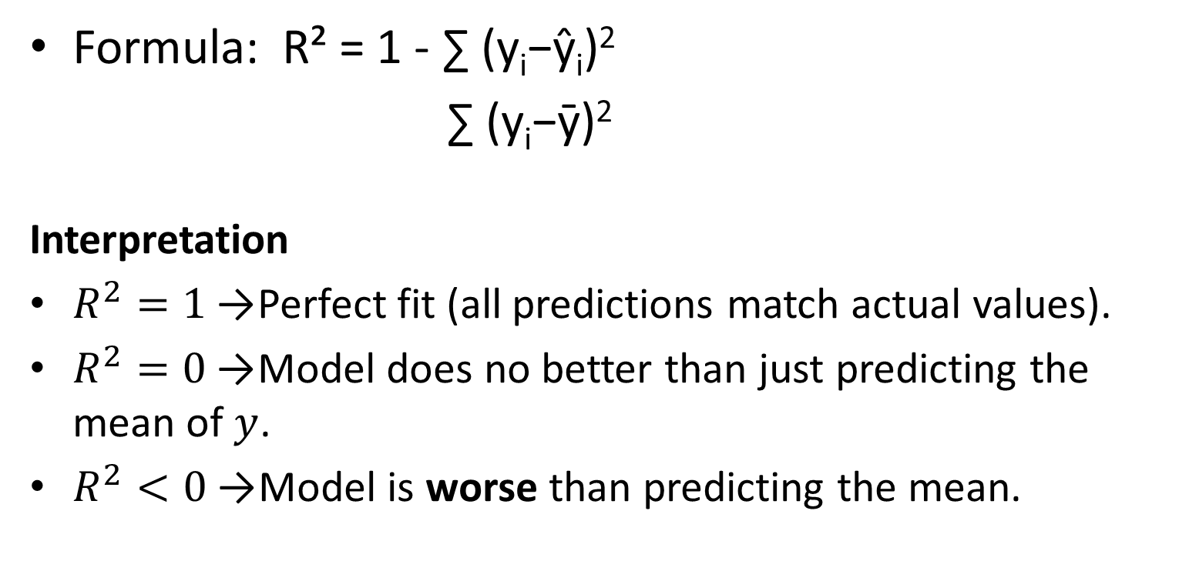
R² Interpretation
Formula: R² = 1 - ∑ (y_{i}​−ŷ_{​i}​)²
∑ (y_{i}​−ȳ)²
Interpretation
$R^{2}=1$→ Perfect fit (all predictions match actual values).
$R^{2}=0$→ Model does no better than just predicting the mean of $y$.
$R^{2}<0$→ Model is worse than predicting the mean.

Slide 10
Residuals & Residual Plots
Residual = y - ŷ (actual – predicted).
Residual plots check assumptions:
Random scatter → Good model
Patterns → Model missing info (non-linearity, bias, etc.)
Helps detect unequal error spread (heteroscedasticity).
What assumptions we check?

Slide 11
1. Linearity
Assumption: The relationship between predictors (X) and response (Y) is linear.
Check: Residuals should be randomly scattered around zero.
Problem sign: A curve or pattern → suggests non-linearity.

Slide 12
2. Independence of Errors
Assumption: Residuals are independent (no correlation between errors).
Check: No obvious patterns in residual sequence (if plotted against time/order).
Problem sign: Clustering or cycles → autocorrelation (common in time series).

Slide 13
3. Homoscedasticity (Constant Variance)
Assumption: Residuals have constant spread across predicted values.
Check: Residual plot should show equal scatter throughout.
Problem sign: “Fan shape” (increasing or decreasing spread) → heteroscedasticity.

Slide 14
4. Normality of Errors (for inference, not prediction)
Assumption: Residuals are approximately normally distributed.
Check: Histogram or Q–Q plot of residuals.
Problem sign: Skewed or heavy-tailed distribution.

Slide 15
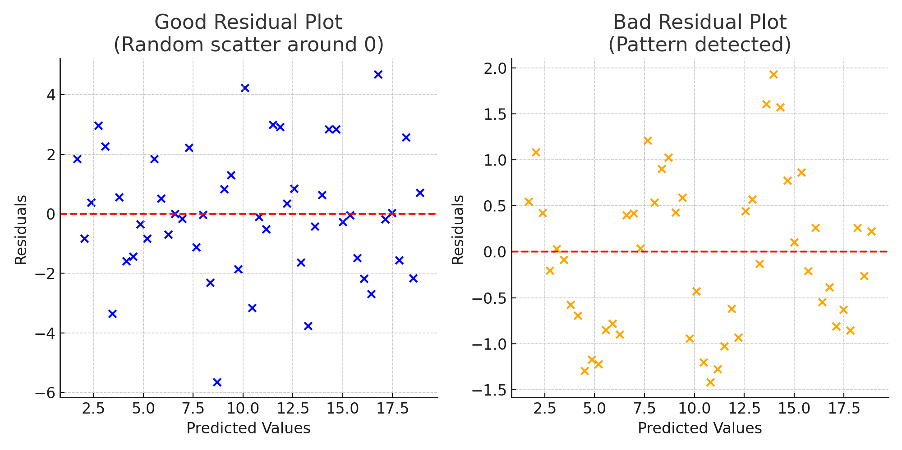

Slide 16
Choosing the Best Model
Compare metrics: Lower MAE, MSE, RMSE = Better.
Check R²: Higher is better (but beware of overfitting).
Look at residual plots: No clear pattern = Good.
Balance: Best trade-off between error and interpretability.

Slide 17
Example Summary Table
Model | MAE | RMSE | R² | Best?
Linear | 4.2 | 5.5 | 0.78 | ❌
Ridge | 3.8 | 5.0 | 0.82 | ✅
Lasso | 4.0 | 5.3 | 0.80 | ❌

Slide 18
Key Takeaways
MAE, MSE, RMSE → Error measurement.
R² → Explains variance captured.
Residual plots → Visual check of fit.
Best model = Low error + High R² + Random residuals.

